Slide 1
Warwickshire
Rural Crime Team
Spring 2026

Slide 2
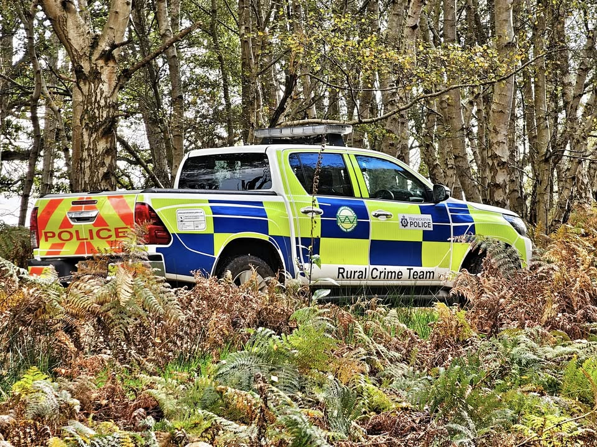
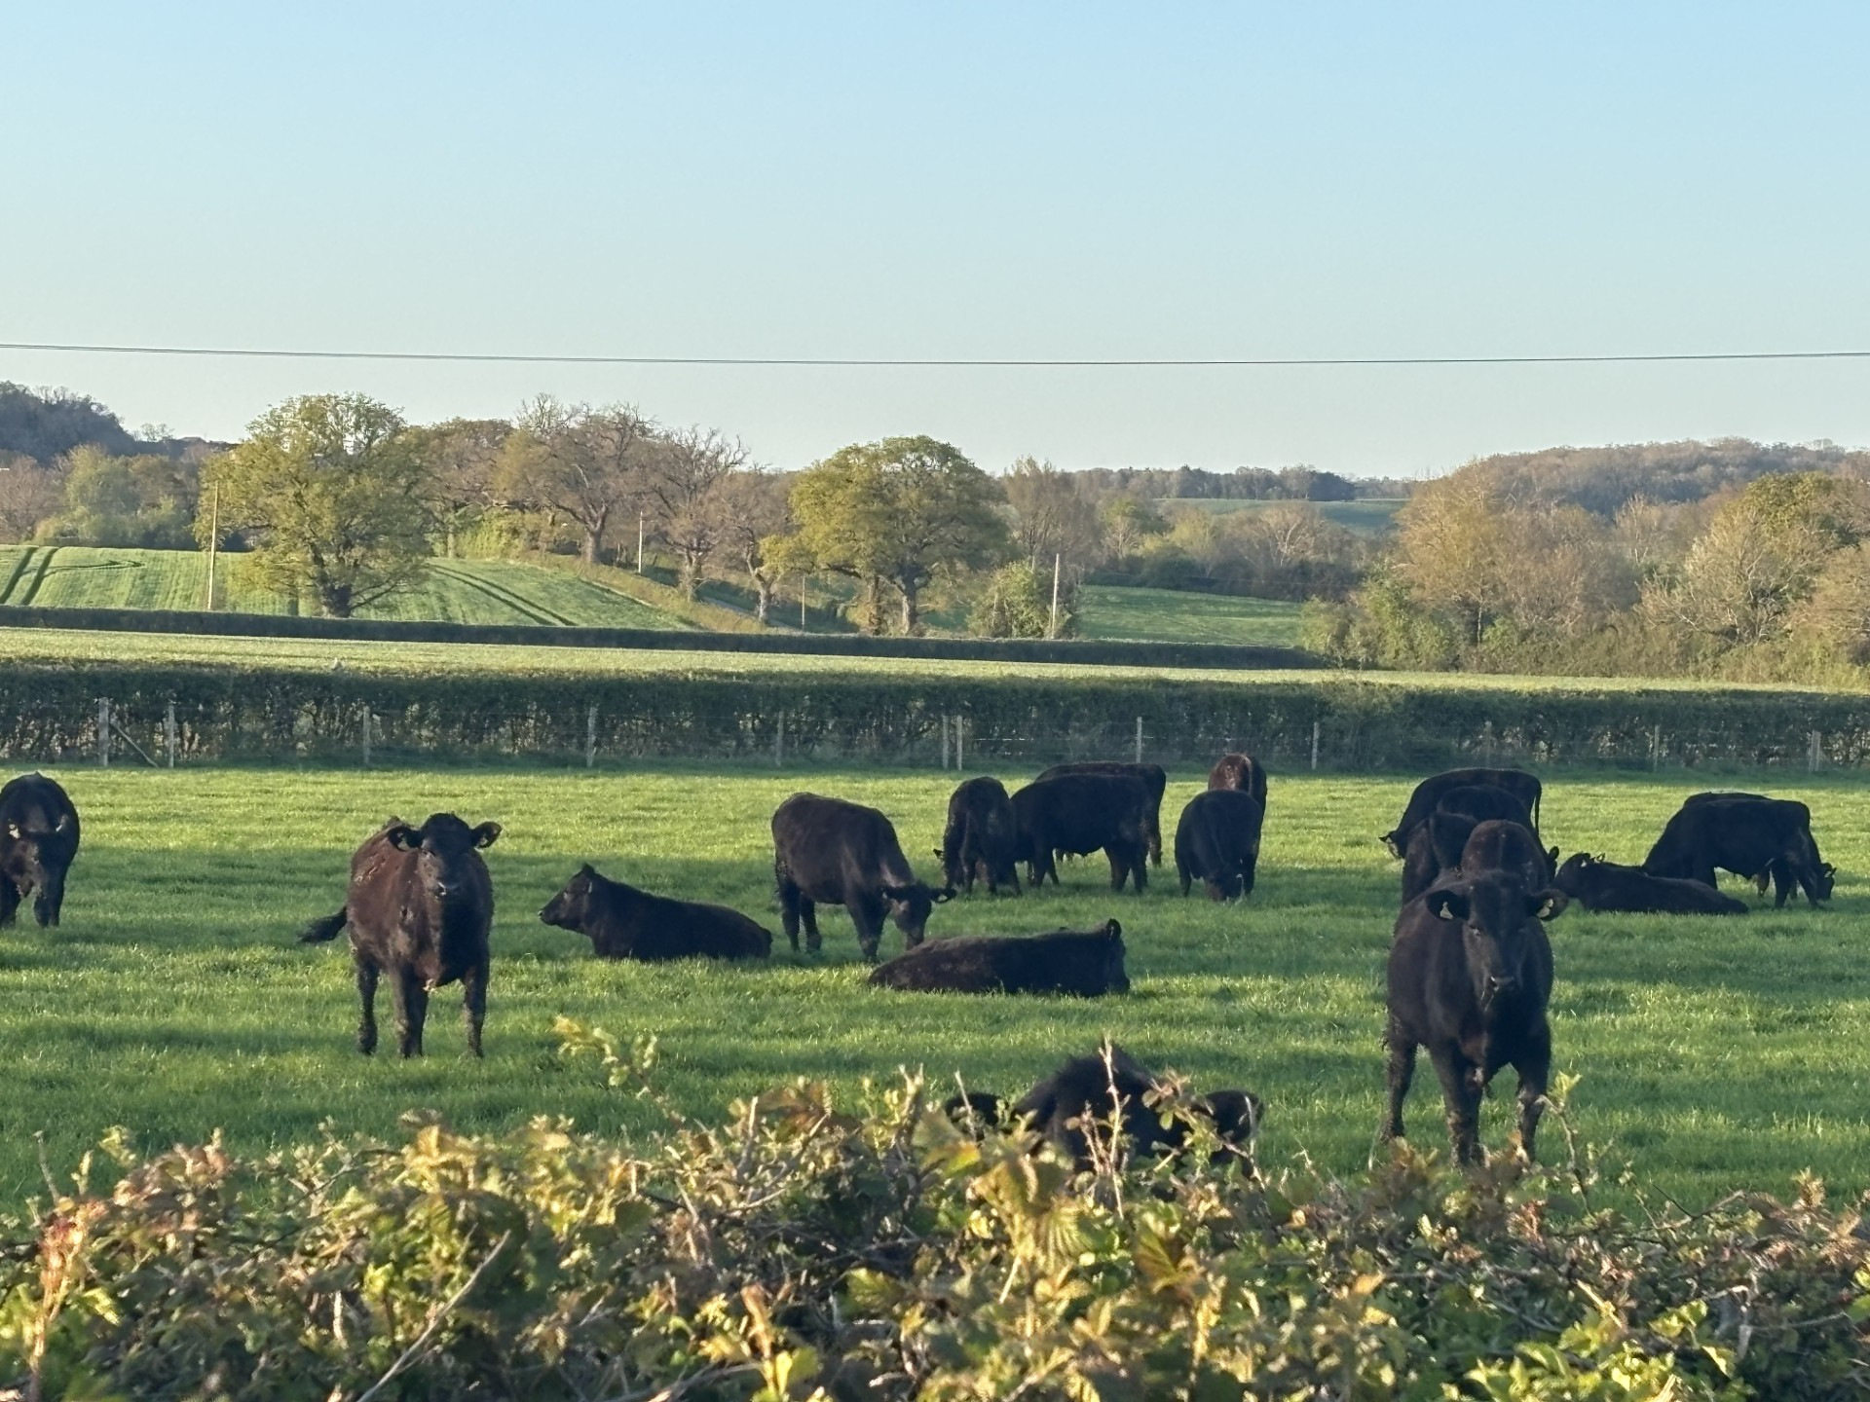
Warwickshire Rural Crime Team
Rural Crime Team Contacts
Countywide
PS 1452 Ruth Day 07557014035 Ruth.Day@Warwickshire.police.uk
PCSO 6241 Jess Charlesworth 07870155300 Jessica.Charlesworth@warwickshire.police.uk
North Warwickshire
PC 2225 Jimmy Trotter 07815009355 James.Trotter@warwickshire.police.uk
PC 2251 Dan Willetts 07814214410 Daniel.Willetts@Warwickshire.police.uk
East Warwickshire
PC 1822 Rebecca Bailey 07890405980 Rebecca.Bailey@warwickshire.police.uk
PC1400 Dan Boxx 07970543975 Daniel.Boxx@warwickshire.police.uk
South Warwickshire
Pc 1442 Andy Steventon 07557033186 Andrew.Steventon@warwickshire.police.uk
PC 1362 Jacob Tyler 07967303124 Jacob.Tyler@warwickshire.police.uk
Please report all incidents via 101/ www.warwickshire.police.uk and 999 always in an emergency.
You can follow further news from the Team on Facebook under:
Warwickshire Rural Crime Team

Slide 3
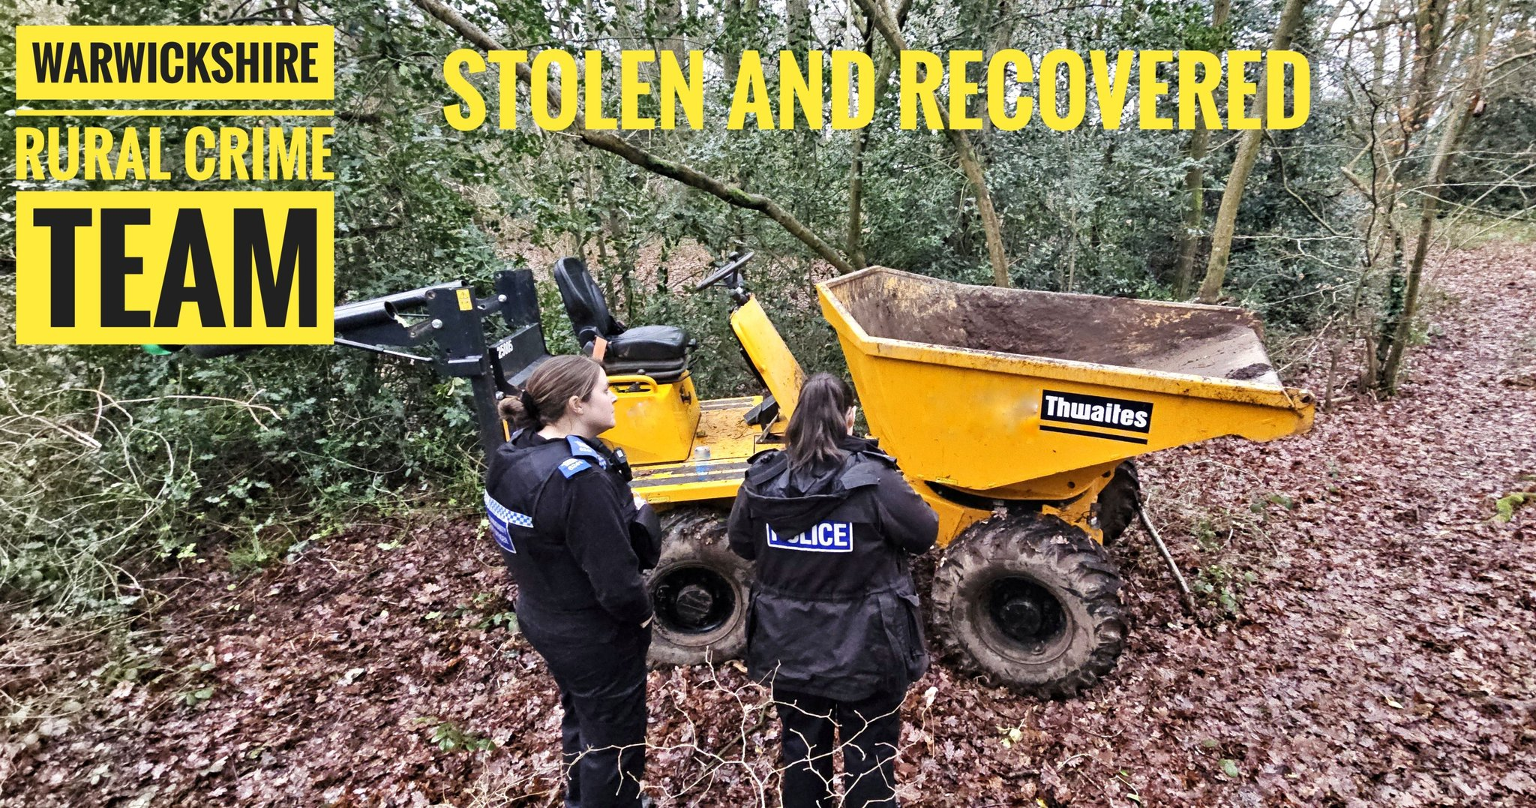
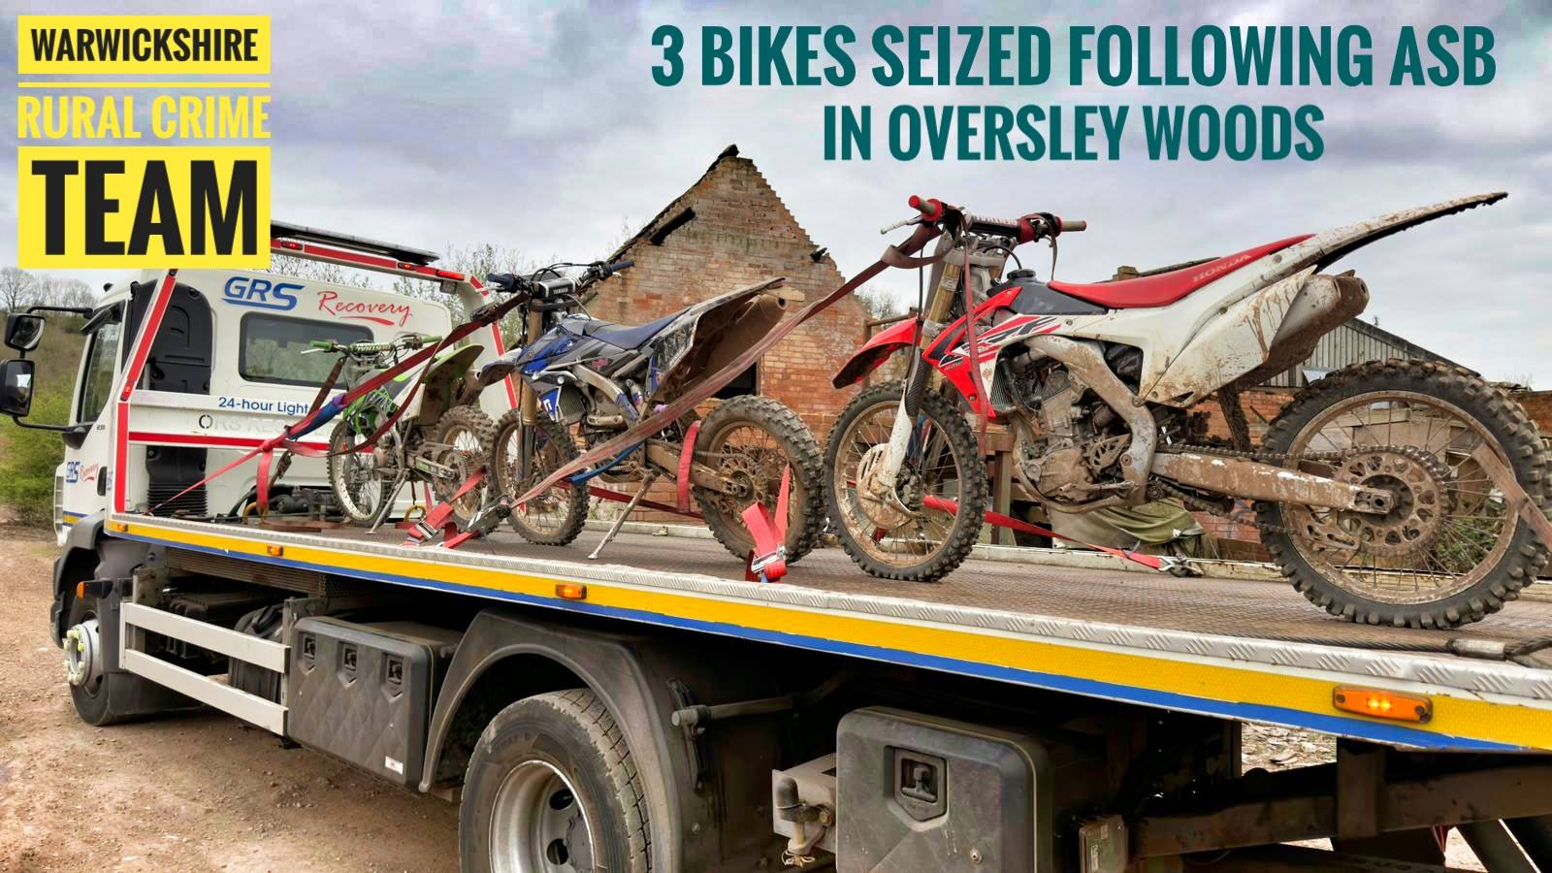
Vehicles and Plant Machinery
After being reported stolen, this 3-tonne dumper thought it had found the perfect hiding spot deep in some woodland near Kenilworth. Unfortunately for the thief, they forgot one important detail… it was being tracked .
Thanks to CanTrack Global Ltd tracker, officers from the RCT were able to locate and recover the dumper in under 24 hours from the time it was stolen.
We’re delighted to have reunited it with the rightful owner.
Colleagues from the Alcester Safer Neighbourhood Team (SNT) made us aware of concerns raised by members of the public regarding anti-social behaviour involving off-road motorbikes in Oversley Woods and surrounding areas.
Oversley Woods is a notable area of ancient woodland, with this, in mind, RCT officers attended the location the same day. It didn’t take long before three off-road motorbikes were located riding within the woods and across nearby farmland. Officers attempted to engage with the riders; however, they chose not to stop.
Working alongside colleagues from Stratford Patrol A Shift, the three riders were located nearby shortly afterwards. All three bikes were seized, and the riders have been dealt with for the offences identified. Areas such as Oversley Woods are protected for a reason—both for wildlife and for the safety and enjoyment of everyone who uses them.
We recognise that many riders enjoy off-road biking responsibly and within the law. Unfortunately, it is the actions of a small minority that risk damaging the reputation of the wider riding community.
We will continue to act on information provided and will use all resources available to us—including drones, 4x4 vehicles, and if appropriate our own off-road bikes—to address illegal activity in our rural spaces.
If you have concerns or information, please report it to us via 101/www.warwickshire.police.uk and always 999 in an emergency.

Slide 4
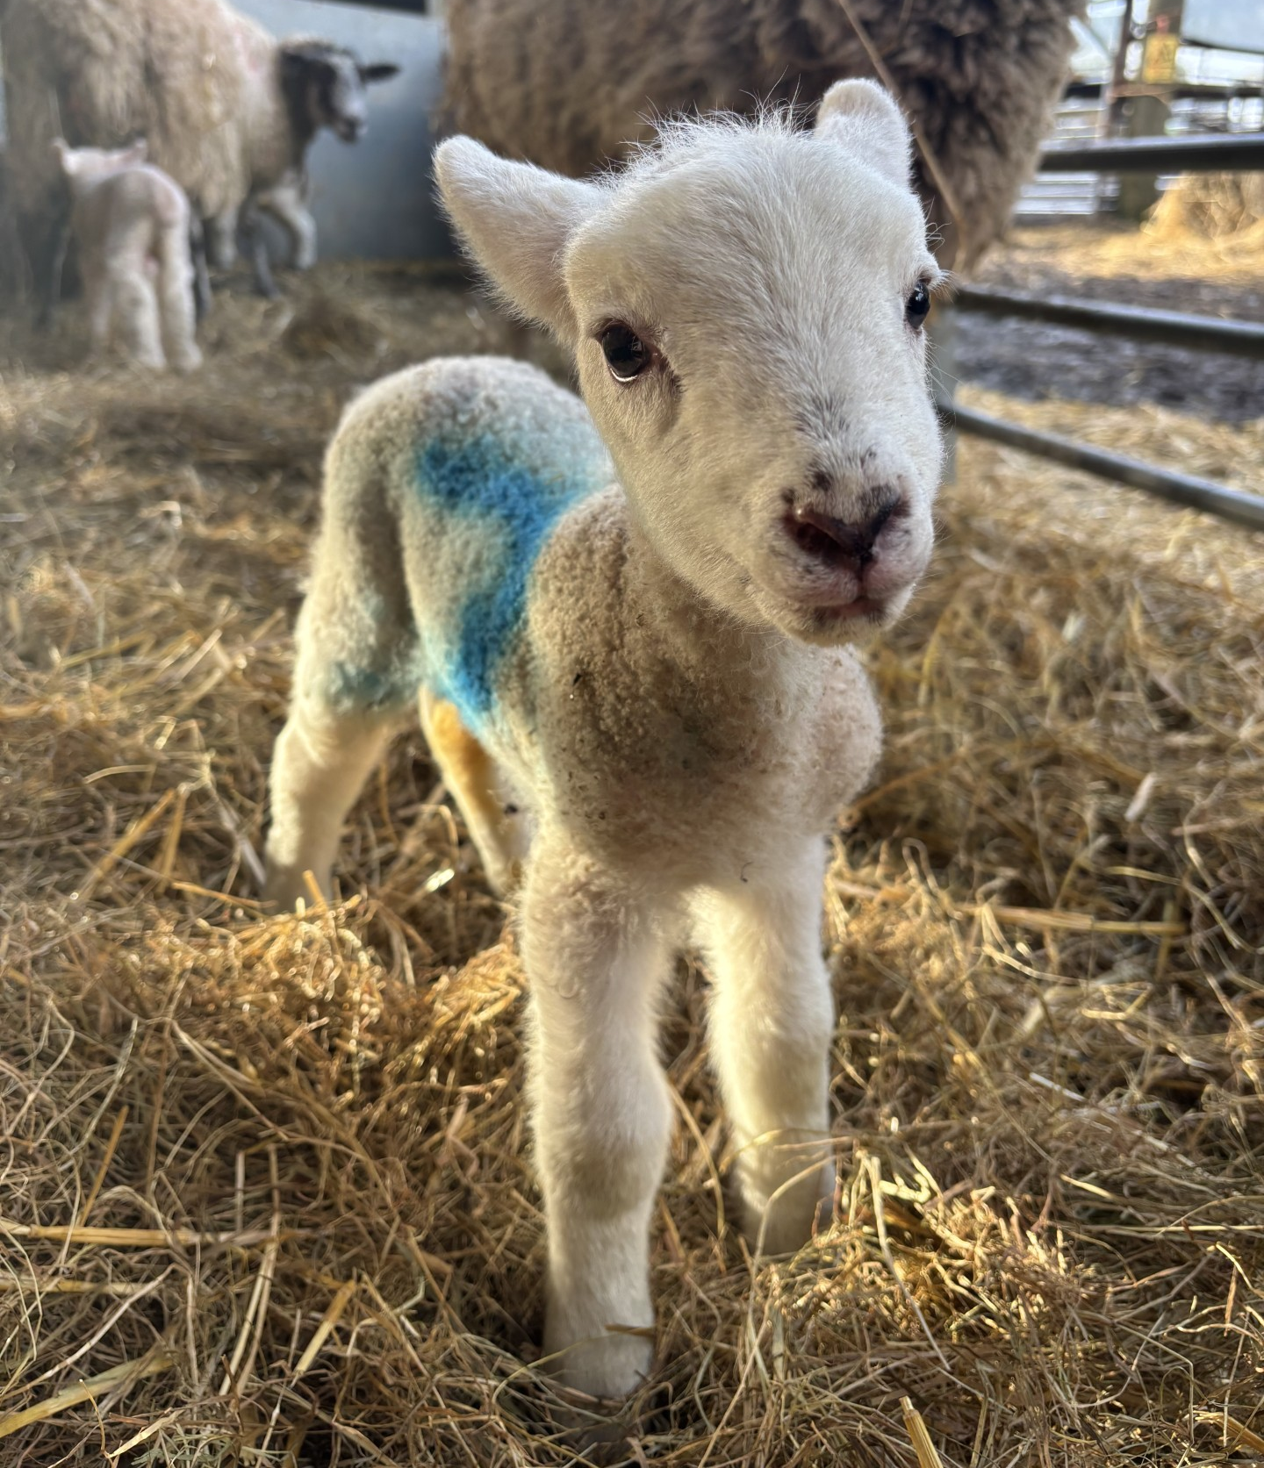
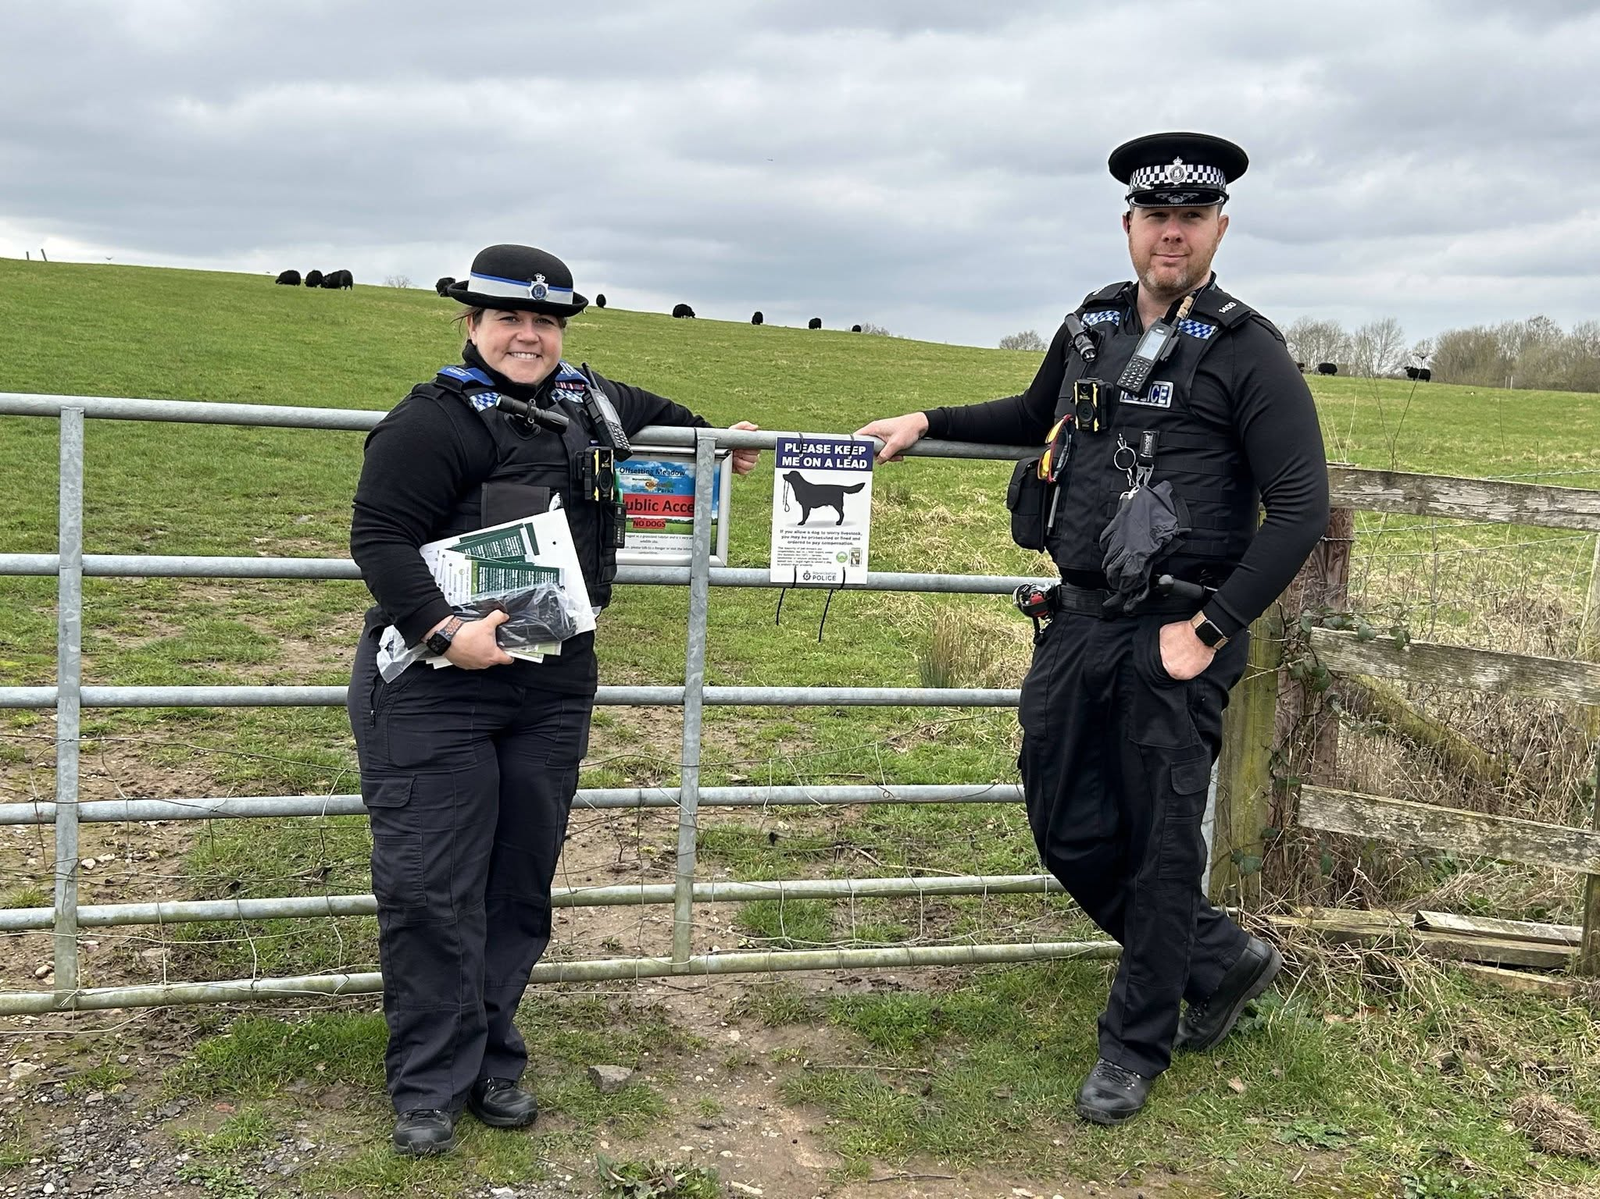
Livestock
Over the last few weeks The Rural Crime Team have been out with different safer-neighbourhood teams, including Warwick Rural East, Rugby, Southam and Warwick Rural West in relation to Op Recall, which is a national initiative to raise awareness around livestock worrying.
We have been speaking with members of the public about the importance of keeping their dogs on a lead and under control around livestock. Thank you to the members of the community we spoke to.
How can you help?
Keep your dog on a lead and under close control.
If you leave your dog outside on it's own, on your property, ensure that it is in a secure area and cannot escape.
Do not go onto private land unless there is a public footpath or you have permission from the landowner.
Stay on designated footpaths.
If you're entering an area where there are other animals give them plenty of space.
Make sure your details are on your dog's collar and it is microchipped, so that you can be reunited quickly if it is lost, plus it is a legal requirement.
If an incident occurs, please report it to police as soon as possible. Early reporting helps us secure evidence, identify the dogs involved and take the necessary action.
Please report any incidents via 101/www.warwickshire.police.uk and always 999 in an emergency.
If you have livestock and would like a “Dog on Lead” sign then please email the team on:
RuralCrimeTeam@warwickshire.police.uk.

Slide 5
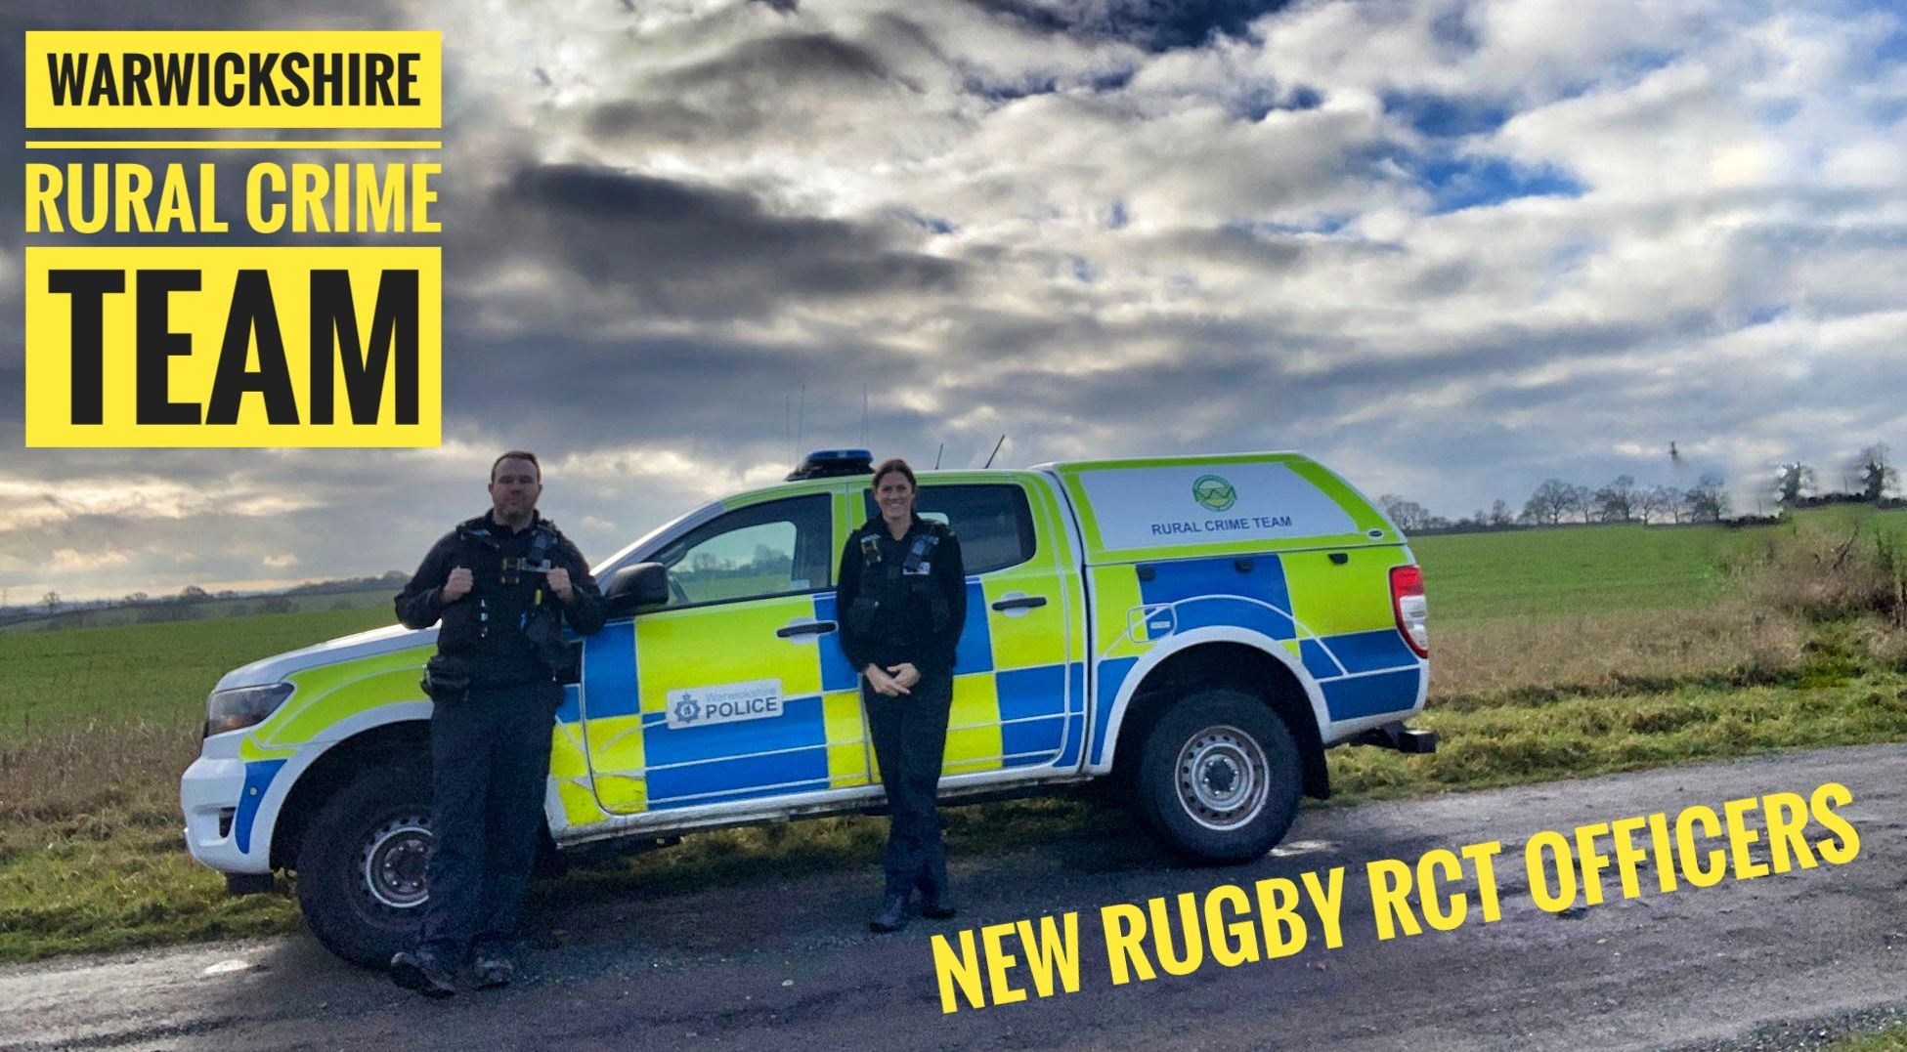
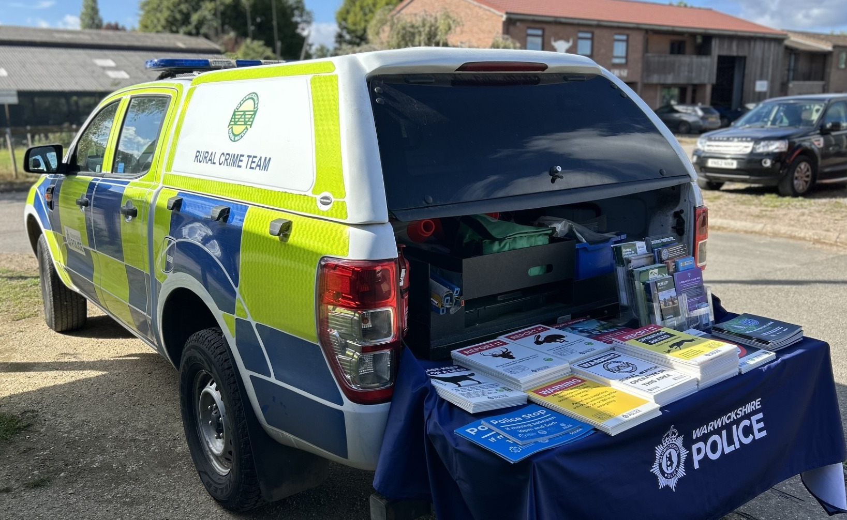
Team News
We’d like to introduce PC Rebecca Bailey and PC Dan Boxx as the newest members of the Rural Crime Team.
Both officers will be based at Rugby Police Station and will be covering the east of the county.
They said:
“We’d love to hear from rural communities, landowners and farmers about any concerns affecting the area.”
“We’re looking forward to protecting our rural communities.”
New Team Members
Engagement
The team have been attending Rugby Farmers Market at Stoneleigh Park regularly on a Monday and a Thursday for a Rural Crime Team drop-in.
Officers are there for members of the public to come and discuss any local concerns.
Dates of our attendance for the following months are:
Monday 1st June between 10:00-11:30hrs
Thursday 11th June between 10:00-11:30hrs
Monday 6th July between 10:00-11:30hrs
Monday 20th July between 10:00-11:30hrs
,

Slide 6


Warwickshire Rural Watch
For advice, then please see Warwickshire Rural Watch for crime prevention advice and information in relation to Rural Matters.
Furthermore, we used to send out information, incidents relating to rural crime and alerts through Warwickshire Rural Watch. This messaging system has now been moved to Warwickshire Connected.
If you would like to receive these messages, then you will need to sign up to Warwickshire Connected. You can do this yourself via Warwickshire Connected or if you need support with this then please contact Jessica.Charlesworth@warwickshire.police.uk.

Slide 7

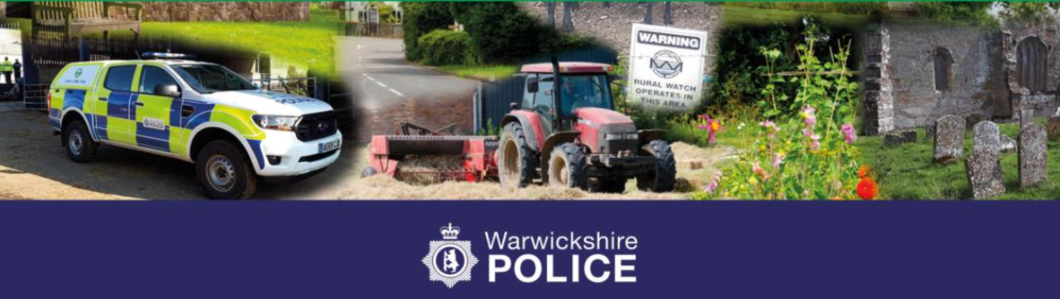
Mounted Volunteers
The Mounted Volunteers scheme is for horse riders and carriage drivers who would like to offer support to Warwickshire Police by being a visible and accessible point of contact with your horse in the local community.
While on your regular ride or carriage drive, we would like you to report anything you feel is suspicious, such as anti-social behaviour, damage or concerns that you have seen or been advised of.
You will not be directly involved in any action - leave that with us to deal with.
There will also be opportunities to promote the British Horse Society’s ‘Dead Slow’ Campaign and ‘Operation Close Pass,’ promoting road safety when passing horses on the highway.
We would also like you to help promote equine crime prevention to help horse owners protect their property and equipment, plus join us at relevant events promoting the scheme around the county.
"Our Mounted Volunteers play a vital role in helping us stay connected with our communities across Warwickshire. Their presence enhances our visibility, supports local events, and provides valuable extra eyes and ears on the ground.
"We’re delighted to relaunch the scheme and welcome volunteers who share our commitment to keeping Warwickshire safe. Their dedication makes a real difference to road safety for all vulnerable road users.”
— Sergeant Day, Warwickshire Police Rural Crime Team

