Slide 1
Warwickshire
Rural Crime Team
Summer 2026

Slide 2
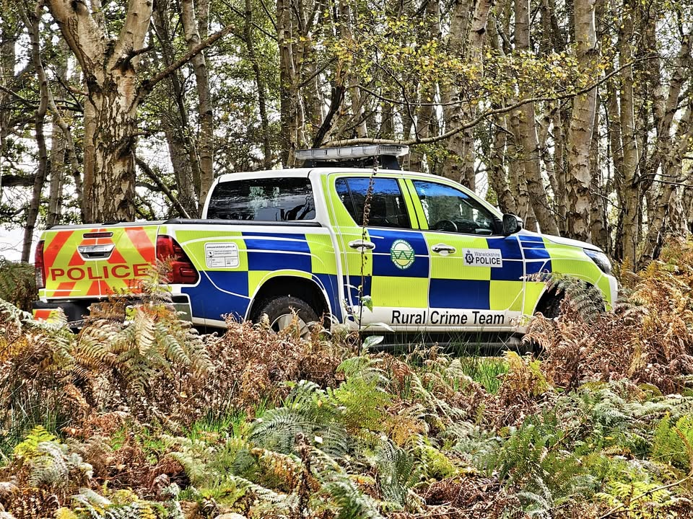
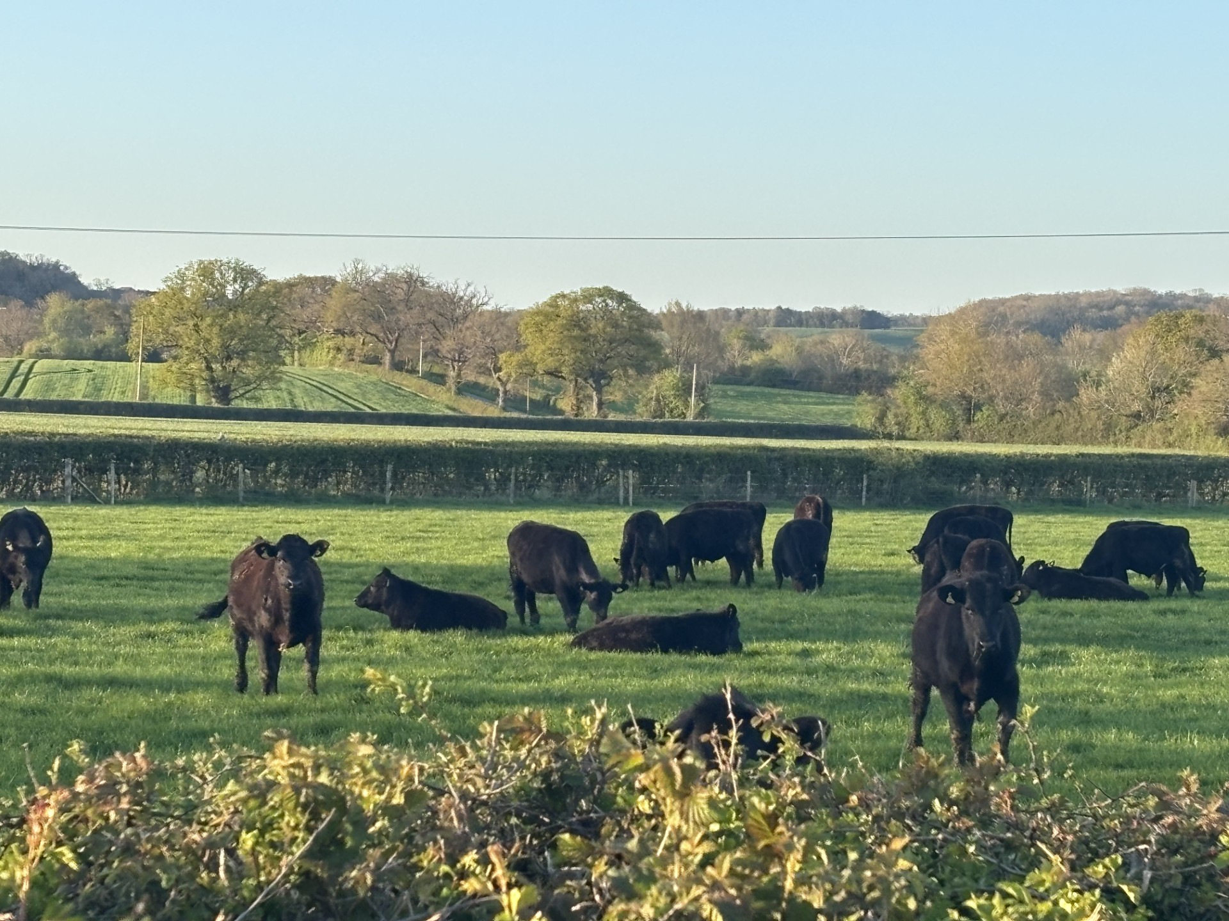
Warwickshire Rural Crime Team
Rural Crime Team Contacts
Countywide
PS 1452 Ruth Day 07557014035 Ruth.Day@Warwickshire.police.uk
PCSO 6241 Jess Charlesworth 07870155300 Jessica.Charlesworth@warwickshire.police.uk
North Warwickshire
PC 2225 Jimmy Trotter 07815009355 James.Trotter@warwickshire.police.uk
PC 2251 Dan Willetts 07814214410 Daniel.Willetts@Warwickshire.police.uk
East Warwickshire
PC 1822 Rebecca Bailey 07890405980 Rebecca.Bailey@warwickshire.police.uk
PC1400 Dan Boxx 07970543975 Daniel.Boxx@warwickshire.police.uk
South Warwickshire
Pc 1442 Andy Steventon 07557033186 Andrew.Steventon@warwickshire.police.uk
PC 1362 Jacob Tyler 07967303124 Jacob.Tyler@warwickshire.police.uk
Please report all incidents via 101/ www.warwickshire.police.uk and 999 always in an emergency.
You can follow further news from the Team on Facebook under:
Warwickshire Rural Crime Team

Slide 3
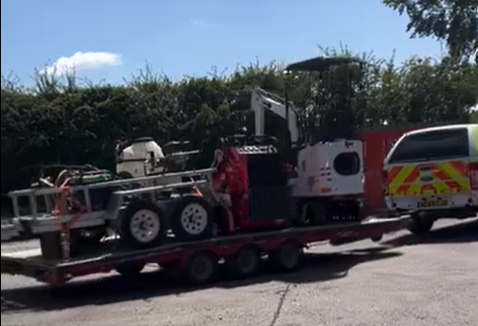

Vehicles and Plant Machinery
On 10th June 2026, Warwickshire Rural Crime Team Police, recovered a large quantity of stolen plant machinery and other items from the Rugby area. £250,000 to be precise.
This is currently an on- going investigation but has involved safely transporting items to a secure unit for us to return the stolen items back to their rightful owners.
On Tuesday 11th August our Rural Crime Team got a tip off about a suspected stolen tractor from our friends at The National Construction and Agricultural Theft Team possibly being held at a site off Stratford Road near Warwick, we headed over to take a look.
Not only did we find what we believe to be that tractor (worth £75k) we also found an array of other items, believe to be stolen, including £23k worth of tyres and even car park matting of the sort used at big festivals.
All in all, it's looking like £500k of items have been recovered!
The Rural Crime Team work with partner agencies, tracking companies and our local communities. If your notice anything suspicious then please do report it. Always call 999 in an emergency or calling 101 report on www.warwickshire.police.uk in non-emergency. You can also contact Crimestoppers anonymously on 0800 555 111.

Slide 4
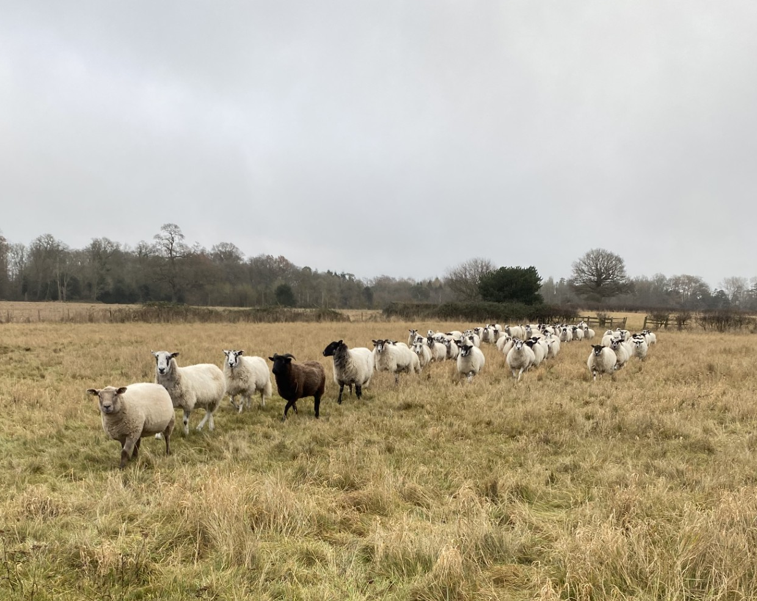
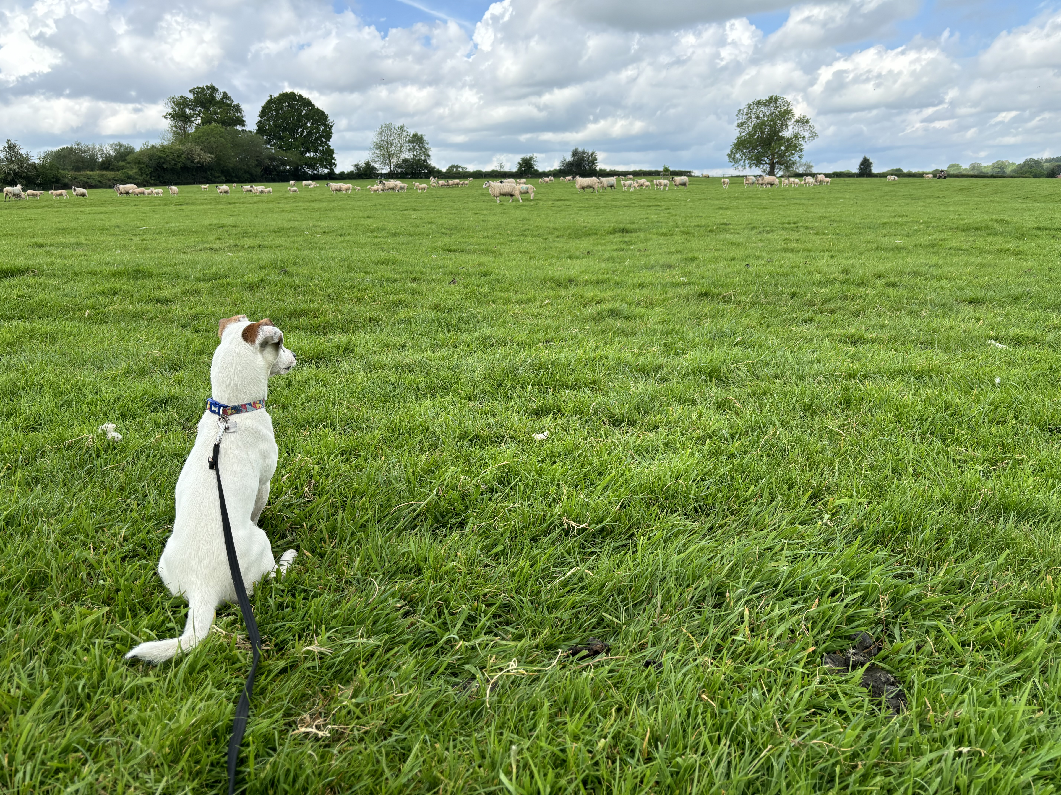
Livestock
Over the last few weeks The Rural Crime Team have been made aware of a few reports regarding Livestock worrying throughout the County.
We understand that we will be coming up to another crucial part of the year with preparation for next years lambing, weaning this year's lambs, flushing ewes (on we hope some kind of pastures after the hot summer) and turning out tups.
If you notice any dogs in with livestock causing alarm at the time of incident this is always a 999 call. If it's safe to do so and you’re happy to please take a video of the incident for officers to use as evidence. The Team understand that this isn’t always possible when trying to get flocks/herds to safety.
How can you help as a dog owner?
Keep your dog on a lead and under close control.
If you leave your dog outside on it's own, on your property, ensure that it is in a secure area and cannot escape.
Do not go onto private land unless there is a public footpath or you have permission from the landowner.
Stay on designated footpaths.
If you're entering an area where there are other animals give them plenty of space.
If an incident occurs, please report it to police as soon as possible. Early reporting helps us secure evidence, identify the dogs involved and take the necessary action.
Please report any incidents via 101/www.warwickshire.police.uk and always 999 in an emergency.
For any dogs on lead signs, please contact the team on RuralCrimeTeam@warwickshire.police.uk
Make sure your details are on your dog's collar, and it is microchipped, so that you can be reunited quickly if it is lost, plus it is a legal requirement.

Slide 5
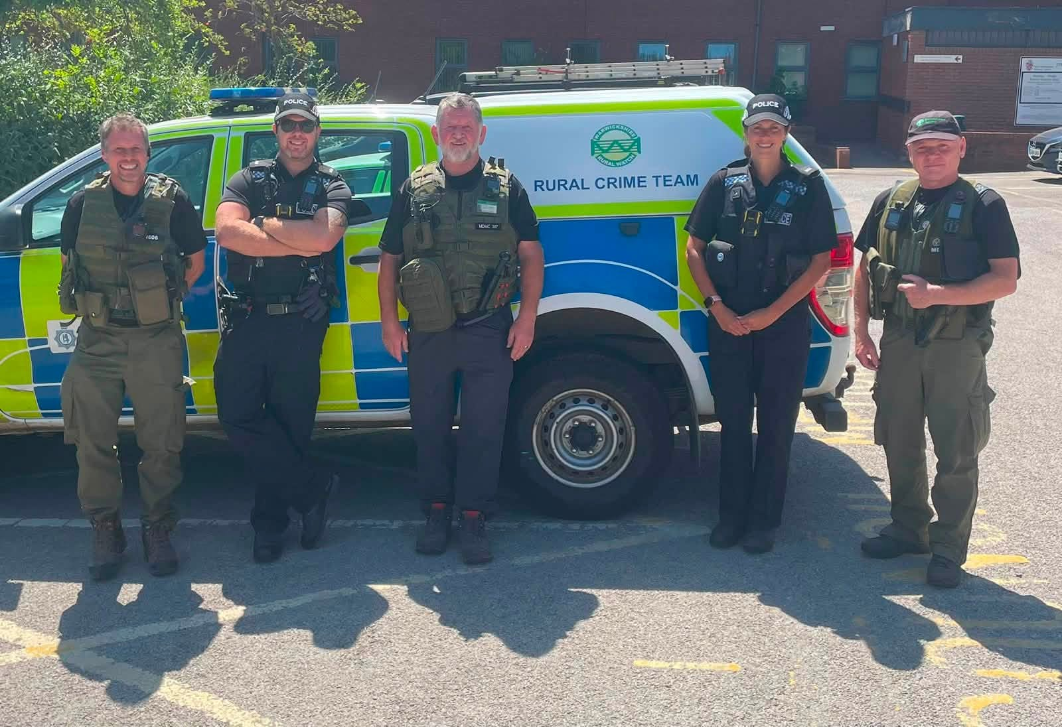
Wildlife
Op Leviathan
You can’t catch fish without a licence… well, you can, but you might catch us too!
This weekend, the Warwickshire Police Rural Crime Team teamed up with the Environment Agency for a two-day operation targeting illegal fishing, anti-social behaviour and rural crime as part of Op Leviathan.
Here’s how we got on:
Visited 14 fishing lakes, pools and reservoirs
Checked 200 rod licences
The Environment Agency dealt with 26 offences
We dealt with 5 fishing offences through Community Resolution for anglers without a valid licence
We also dealt with 2 cannabis possession offences by Community Resolution
Thankfully, the vast majority of anglers we met were enjoying the sport responsibly (and probably catching more fish than the licence-dodgers!).
The moral of the story? Before you cast your line, make sure you’ve got a valid rod licence. They’re much cheaper than the alternative… and far less awkward than explaining yourself to a police officer and an Environment Agency bailiff at the water’s edge!
A big thank you to our colleagues at the Environment Agency for another successful joint operation protecting Warwickshire’s waterways and countryside.
Fish responsibly. Bin your litter. Buy your licence.

Slide 6
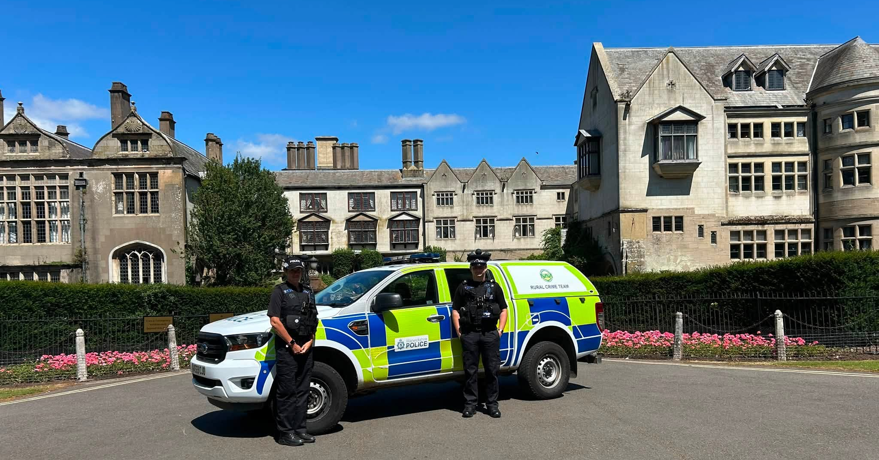
Heritage Crime
Between 29th June to 5th July, it was Heritage Crime and ASB awareness week, a spotlight on the impact anti-social behaviour can have on the places that tell our story.
From ancient woodland tracks and historic farmsteads to listed buildings, monuments and archaeological sites, our heritage is something we all share and all have a responsibility to protect.
Example of heritage incidents and crimes:
Off-road vehicles damaging historic earthworks,
Littering and fly-tipping at beauty spots,
Graffiti and vandalism on listed structures,
Illegal metal detecting and disturbance of protected sites…
The effects can last for decades—or even centuries—and once history is lost, it cannot be replaced.
Throughout the week, our officers engaged with visitors, staff and volunteers at:
Warwick Castle
Kenilworth Castle
Coombe Abbey
Middleton Hall
Alvecote Priory
These visits help strengthen partnerships, raise awareness of heritage crime and anti-social behaviour, and reinforce our commitment to protecting the places that make Warwickshire so unique.
From patrolling the historic walls of Kenilworth Castle to visiting the stunning grounds of Middleton Hall, we’ve had the opportunity to speak with local communities and those who work tirelessly to preserve these important landmarks.

Slide 7

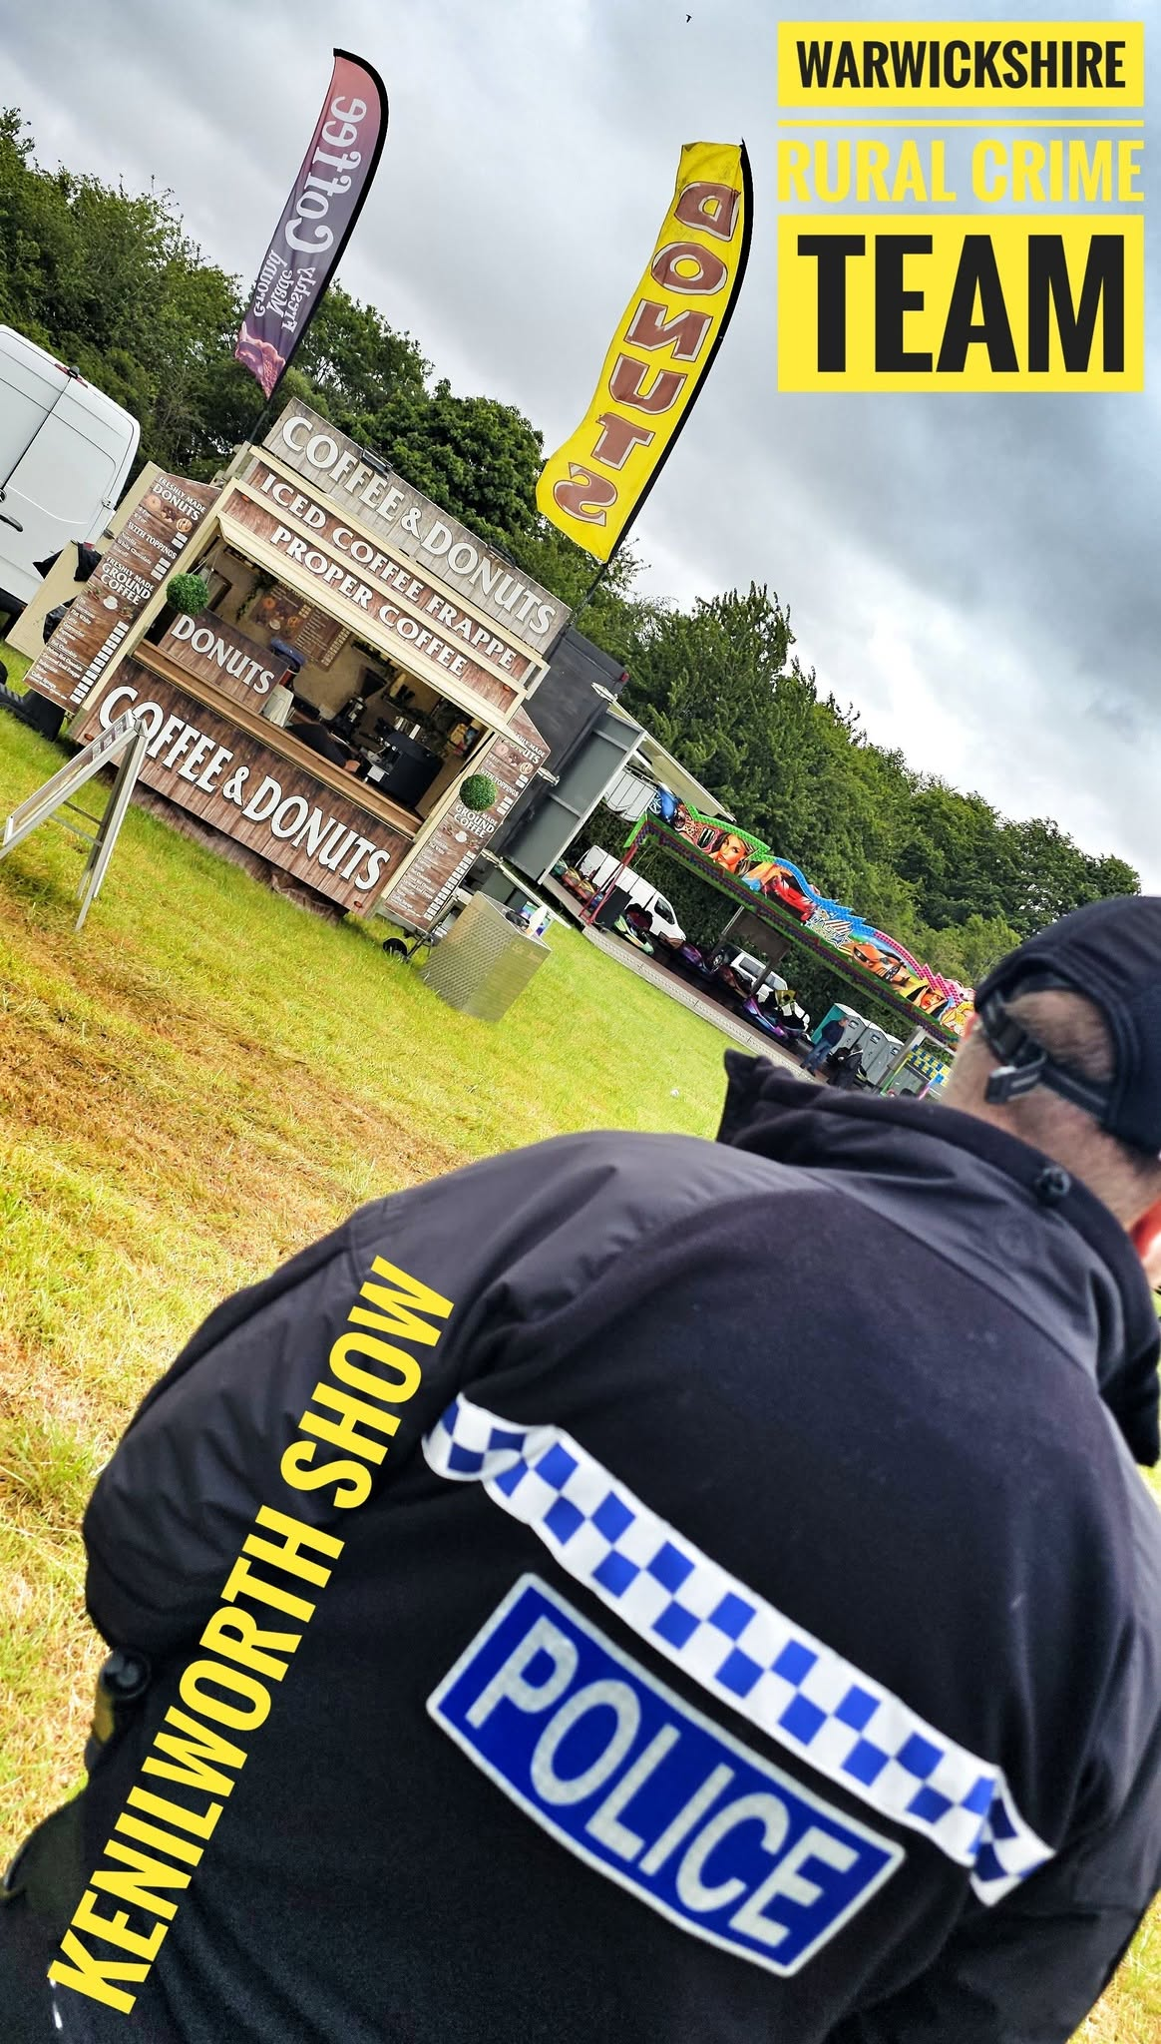

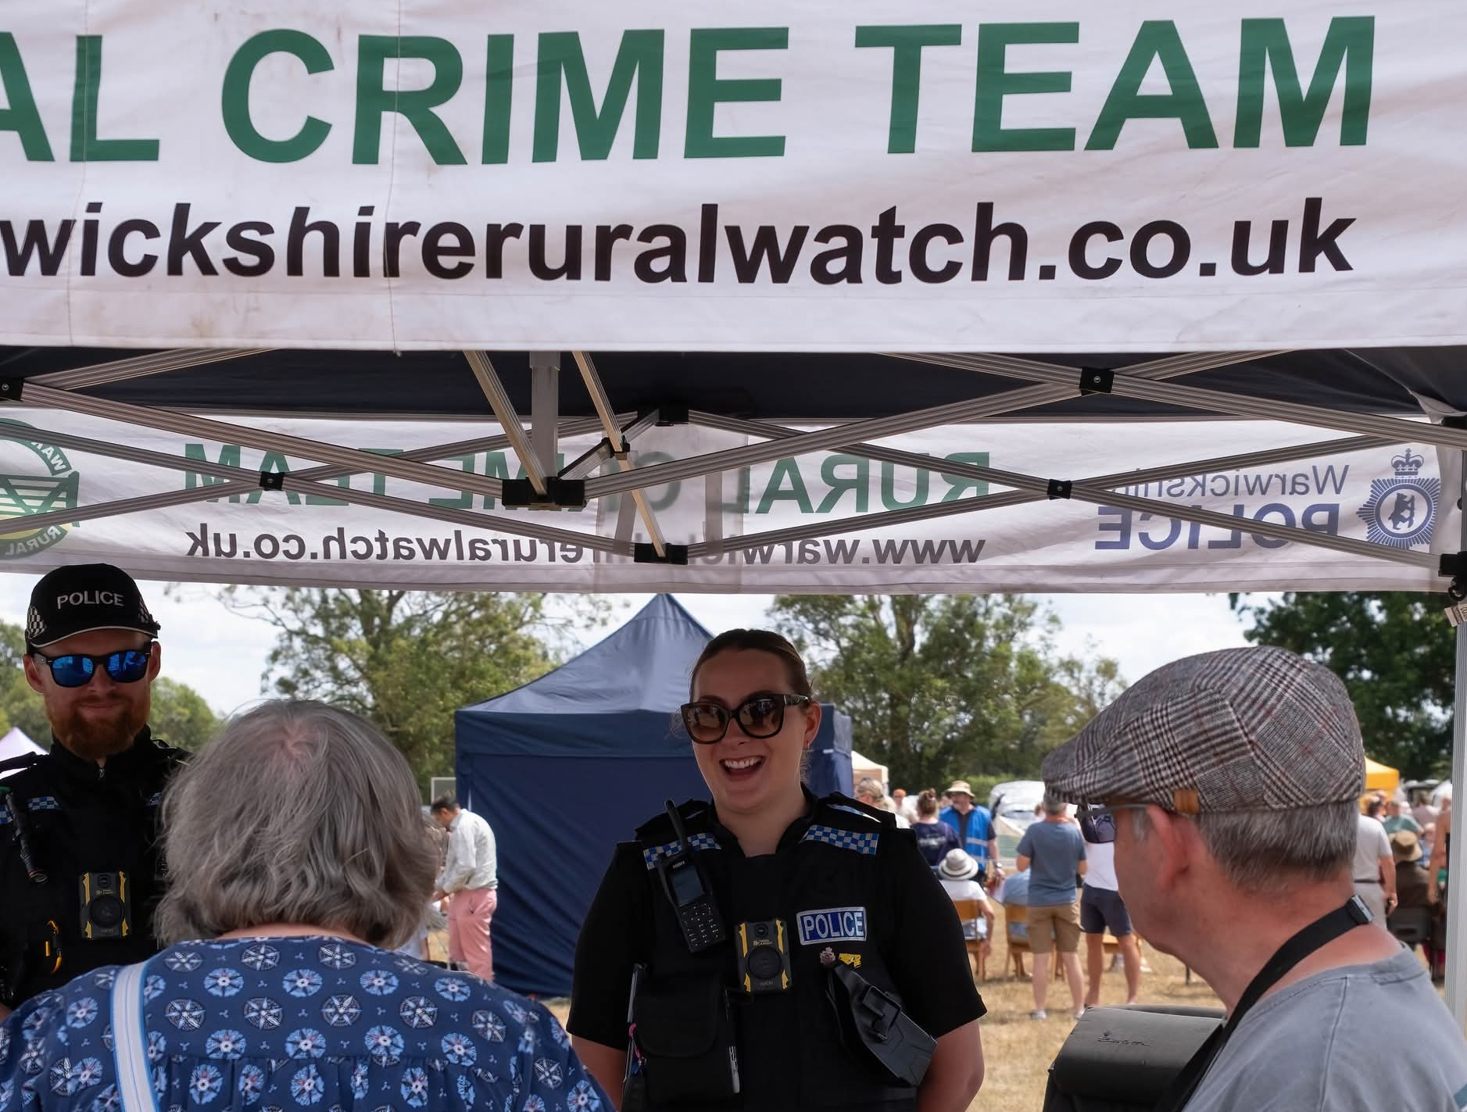
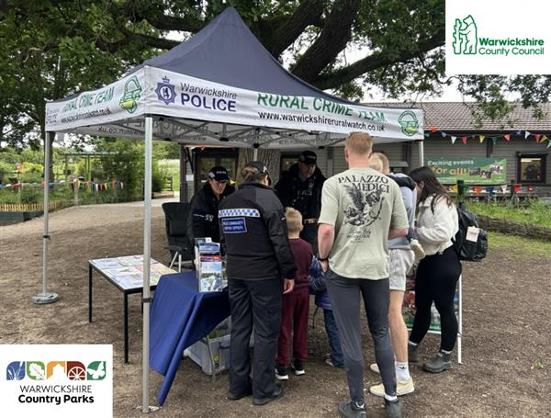
Team News
Community Engagements
The Team have attended a few community events over the last few months, including Farm Fest, The Kenilworth Show, Wildlife Event at Ryton Pools, Game Fair, Dassett Country Show and continuing with Rugby Farmers Market drop-ins at Stoneleigh Park. These events are a way for our community to come along and have a chat to discuss any local concerns and for officer to inform the community with any relevant information.
,

Slide 8

Warwickshire Rural Watch
The team used to send out information, incidents relating to rural crime and alerts through Warwickshire Rural Watch. This messaging system has now been moved to Warwickshire Connected.
If you would like to receive these messages, then you will need to sign up to Warwickshire Connected. You can do this yourself via Warwickshire Connected or if you need support then please contact Jessica.Charlesworth@warwickshire.police.uk.

